Slide 1
Introduction to Programming with Python
Randyll Bearer, Caroline França, and Matthew Badger

Slide 2
The Basics
Computers are made up of components [Hardware]:
Motherboard
Processor
Memory
Keyboard/Mouse
Etc…
While all computers have these components, not all components are the same
Hardware stores information as bits
Smallest unit of data, is used in patterns to represent larger concepts [Binary Data]
Program code is converted into Binary Data through Compilers and Interpreters

Slide 3
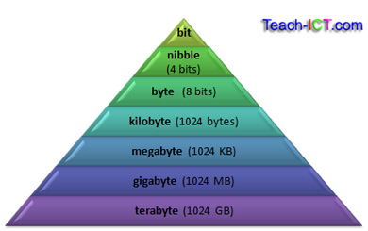
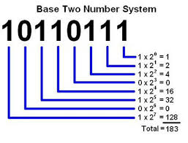
While all computers have these components, not all components are the same
- Python creates a Virtual Machine to dodge this problem.
- Python emulates the same Virtual Machine on every computer

Slide 4
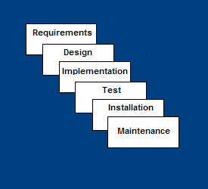
Software Development Process
Requirements – defines needed information, function, behavior, performance and interfaces.
Design – data structures, software architecture, interface representations, algorithmic details.
Implementation – source code, database, user documentation, testing.

Slide 5
Gathering Requirement
Requirements are very well known
Product definition is stable
Technology is understood
Porting an existing product to a new platform.

Slide 6
Solving a Problem
Before you write any code you will want to write a flowchart outlining what will be performed
Ovals = starts and stops, Parallelograms show input/output, rectangles show computation, and diamonds show decisions
Next you will want to write some pseudocode which is a rough outline of the program you will ultimately write
After that you will want to transfer your pseudocode into the program

Slide 7
Solving a problem continued
Once you have written your code you will want to meet with your client and test the code in the various ways it will be used
If the program runs smoothly through this testing then you are finished

